Slide 1
Session 3 Notes
Networking Protocols
Deep Dive
Understanding DNS, TCP, and UDP — The Foundation of Internet Communication
DNS Architecture
TCP Protocol
UDP Protocol

Slide 2
Overview
Contents
01
Domain Name System
02
TCP Protocol
The Internet's phonebook translating domain names to IP addresses through hierarchical resolution
Reliable, connection-oriented protocol ensuring ordered data delivery with error handling
DNS Resolution
Caching
3-Way Handshake
Retransmission
03
UDP Protocol
04
Protocol Comparison
Fast, connectionless protocol for real-time applications without delivery guarantees
Side-by-side analysis of TCP vs UDP — characteristics, use cases, and performance trade-offs
Low Latency
Streaming
Trade-offs
Use Cases

Slide 3
01
Chapter 01
Domain Name
System
The Internet's Phonebook — How Domain Names Map to IP Addresses
Hierarchical Resolution
Global Distribution

Slide 4
01
DNS Fundamentals
DNS = Domain Name System — translates human-readable domain names into machine-readable IP addresses.
Management: Managed by ICANN(Internet Corporation for Assigned Names and Numbers), a non-profit organization responsible for coordinating the global internet's systems of unique identifiers
The Library Analogy:
⊙
You (User)
⊞
Librarian (DNS Resolver)
Want to find a website — type in a domain name like google.com
Helps locate the website by translating domain names to IP addresses
◈
Index System (DNS Hierarchy)
⬡
Book (Website)
Root, TLD, and Authoritative nameservers map domain names(titles) to IP locations
Final destination found — IP address returned, website loads in browser

Slide 5
02
DNS Resolution Process: How DNS works?
Step-by-step journey from domain name to IP address.
1
Checking Local Cache
Before making external requests, your system checks local storage for previously resolved domains.
Browser Cache, OS-Level Cache(if OS has ever visited like different browser)
2
DNS Resolver / Recursor (Like Recursion function that can call itself) (bcz DNS is calling these by itself, that is why called Resolver / Recursor
If local cache misses, request goes to a DNS Resolver — like a librarian who helps find the right section.
ISP Default: Google 8.8.8.8, Cloudflare 1.1.1.1 (ISP has 2 protocol/DNS resolvers either google’s or Cloudfair’s, check in pc network settings)
3
Root Nameservers
The resolver asks Root Nameserver — acts like an index in a library. It directs to the correct TLD server based on domain extension (e.g., .com).
4
TLD Nameserver
The .com TLD nameserver acts like a section dedicated to .com domains. It knows where to find codersgyan.com and directs to the Authoritative Nameserver.
5
Authoritative Nameserver
Holds the final answer — provides the exact IP address (e.g., 104.21.16.1). The resolver sends it back to your browser to load the website.

Slide 6
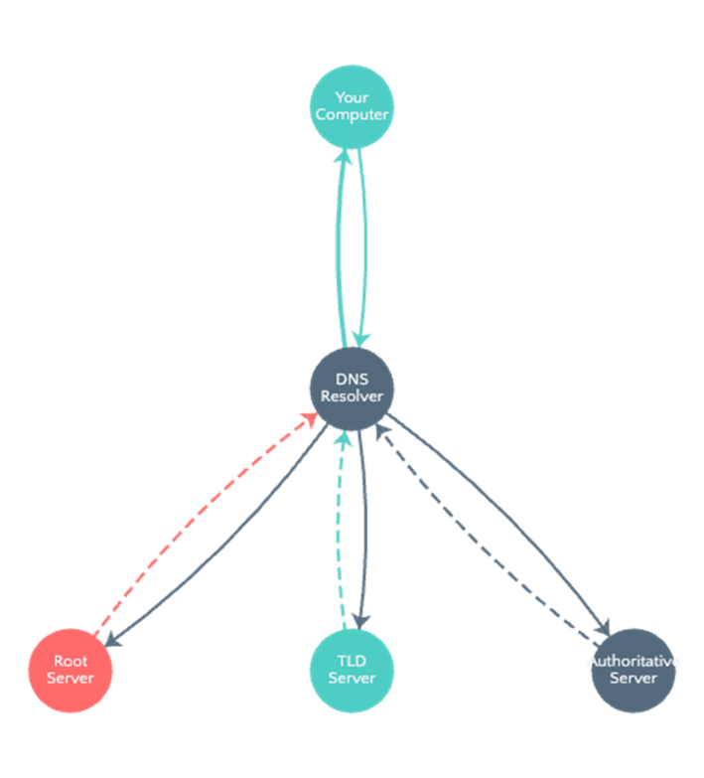
DNS Resolution Flow

Slide 7
03
DNS Caching & Propagation
DNS changes propagate globally over time due to TTL (Time-to-Live) settings on cached records.
Three Levels of Caching
Why Updates Take Time?
DNS changes take time to propagate globally because Root, TLD, and Authoritative Nameservers worldwide need to update their records.
TTL (Time-to-Live): Determines how long DNS records are cached before refreshing. Lower TTL = faster updates but more queries.
Why Not Direct ICANN Communication?
Our request doesn't go directly to ICANN. Instead, it interacts with DNS Resolvers , which handle communication with Root, TLD, and Authoritative Nameservers. This distributed system makes the process efficient and scalable.
Caching Benefits
Faster Loading
Websites load faster by avoiding repeated DNS lookups for frequently visited sites
Reduced Traffic
Lessens the overall burden on DNS infrastructure and network bandwidth
Improved Reliability
Local caching provides fallback if DNS servers are temporarily unavailable
⊞
Browser Cache
Stores previously visited domain records to avoid repeated lookups for sites you visit frequently.
⊙
OS-Level Cache (DNS Client)
Operating system maintains a temporary DNS cache for all applications running on the device.
◈
DNS Resolver Cache
ISPs and providers (Google 8.8.8.8, Cloudflare 1.1.1.1) maintain large shared caches.

Slide 8
02
Chapter 02
TCP
Protocol
Transmission Control Protocol — Reliable, Connection-Oriented Communication
Guaranteed Delivery
Ordered Data

Slide 9
04
TCP Fundamentals
What is TCP?
Why Use TCP?
TCP (Transmission Control Protocol) is one of the main protocols of the TCP/IP suite, lying between the Application and Network Layers.
• Connection-oriented protocol
• Breaks data into segments
• Reassembles at destination
• Multiple route capability
TCP/IP Protocol Stack
Application Layer
HTTP, SMTP, FTP
Transport Layer ← TCP
Reliable data transfer
Network Layer
IP, routing
Physical Layer
Hardware, cables
Reliability: Acknowledgment and retransmission mechanism ensures lost or corrupted segments are resent — critical for file transfers and emails.
Ordered Delivery: Guarantees data is received in the same sequence it was sent, preventing misordered data issues
Congestion & Flow Control: Adjusts transmission rate based on network conditions and receiver capacity to optimize throughput.
Universality: used by HTTP, SMTP, FTP — every segment has a checksum. for error detection and correction.

Slide 10
09
TCP Headers Structure
Every TCP segment contains a header (20–60 bytes) with control information. TCP Header Format
Source Port · 16 bits
Port number of the sending application
Destination Port · 16 bits
Port number of the receiving application
Sequence Number · 32 bits
Byte position of the first data byte in current segment
Acknowledgment Number · 32 bits
Sequence number of next byte expected by receiver
Data Offset + Reserved + Flags · 16 bits
Header length, reserved bits, control flags (SYN, ACK, FIN, etc.)
Window Size + Checksum + Urgent · 48 bits
Flow control window, error detection checksum, urgent pointer
Options + Padding · Variable
Optional fields for additional functionality
DATA/ NATA??? · Variable

Slide 11
09
TCP Headers Structure
Key Header Fields
Source Port · 16 bits
Identifies the sending application (e.g., port 80 for HTTP)
Destination Port · 16 bits
Identifies the receiving application on the target host
Sequence Number · 32 bits
Tracks byte position for ordered reassembly
Acknowledgment Number · 32 bits
Confirms receipt and indicates next expected byte
Checksum
Error detection value to ensure data integrity
Header Size
Varies from 20 bytes (minimum) to 60 bytes (with options)

Slide 12
10
TCP 3-Way Handshake
The process to establish a reliable connection before any data transfer begins.
1
Step 1 · Client Sends SYN
Client sends a SYN (Synchronize) packet to the server. Client→Server: Seq=1000, Ack=0, Flag=SYN (ISN randomly chosen for security)
2
Step 2 · Server Sends SYN-ACK
Server receives SYN and responds with SYN-ACK. Server→Client: Seq=5000, Ack=1001, Flag=SYN-ACK (Server ISN=5000, Ack = Client ISN + 1)
3
Step 3 · Client Sends ACK
Client receives SYN-ACK and sends ACK back. Connection established! Client→Server: Seq=1001, Ack=5001, Flag=ACK (Ack = Server ISN + 1, confirming receipt)

Slide 13
11
TCP Data Transfer & Retransmission
Practical example: Transferring a 3MB image file over TCP.
1
3-Way Handshake
Connection must be established before any data transfer begins.
2
Creating Segments
File: 3,145,728 bytes · MSS: 1,460 bytes/segment · Total segments: ~2,155
3
Data Transfer Process
Send segment (Seq=1001, 1,460B) → Server ACKs (Ack=2461) → Next segment (Seq=2461) → repeat until all 3MB transferred
4
TCP Retransmission
Triggers: packet lost · checksum fails · no ACK received · Timeout: Linux ~200ms–3s, Windows ~300ms–3s · Exponential Backoff: 1s→2s→4s→8s...

Slide 14
03
Chapter 03
UDP
Protocol
User Datagram Protocol — Fast, Connectionless Communication
Low Latency
Real-time Streaming

Slide 15
13
UDP Characteristics & Use Cases
What is UDP?
UDP (User Datagram Protocol) is a Transport layer protocol that breaks data into segments for transmission — fast and connectionless, trading reliability for speed.
UDP Header Structure
Common Use Cases
Source Port
16 bits (2 bytes)
Port number of the sending application
⊞
Video Calling · WebRTC
Destination Port
16 bits (2 bytes)
Port number of the receiving application
◈
Online Gaming · Low latency
Length
16 bits (2 bytes)
Total length of UDP header + data
⊙
DNS Queries · Fast lookup
Checksum
16 bits (2 bytes)
Error detection value (optional in IPv4)
↗
Live Streaming · Real-time
Total Header Size: 64 bits (8 bytes)
Key Differences from TCP:
No delivery guarantee · No acknowledgment numbers · Faster — no retry mechanism means lower latency and overhead · No connection setup

Slide 16
14
TCP vs UDP: Key Differences
TCP
UDP
Connection Type
Connection-oriented
Connectionless
Reliability
Guaranteed delivery with ACK
No delivery guarantee
Speed
Slower (overhead)
Faster
Ordering
Ordered delivery guaranteed
No ordering
Error Handling
Retransmission on failure
No retransmission
Header Size
20–60 bytes
8 bytes only
Handshake
3-way handshake required
No handshake
Use Cases
Web, Email, File Transfer
Streaming, Gaming, DNS

Slide 17
Summary
Key Takeaways
⊞
DNS
⟳
TCP
↗
UDP
Translates domain names to IP addresses through hierarchical resolution involving Root, TLD, and Authoritative nameservers.
Provides reliable, ordered data delivery with connection establishment via 3-way handshake and comprehensive error handling through retransmission.
Offers fast, connectionless communication ideal for real-time applications like video streaming, gaming, and DNS queries.
Each protocol serves different needs — TCP for reliability, UDP for speed — forming the backbone of modern network communication.

